Slide 1
Handling tooling and working platforms for the Vacuum Vessel
Information for market survey

Slide 2
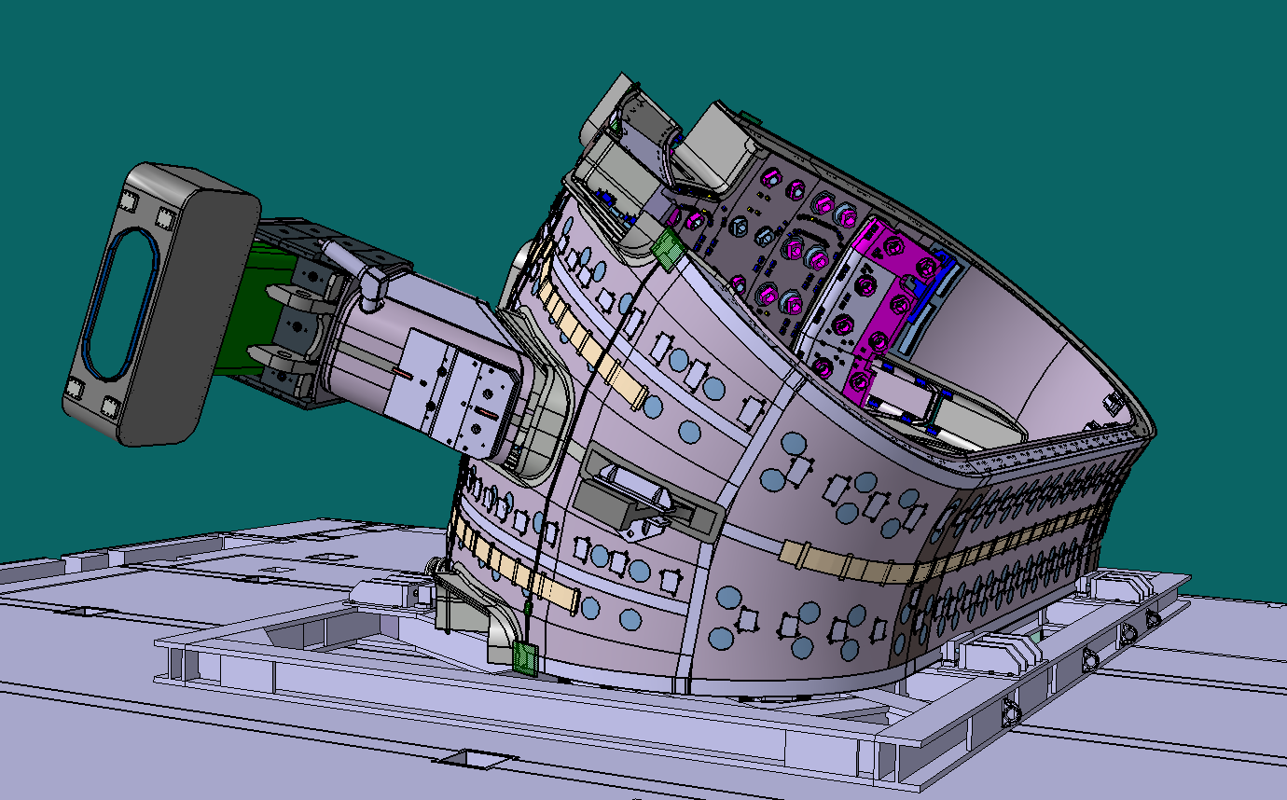
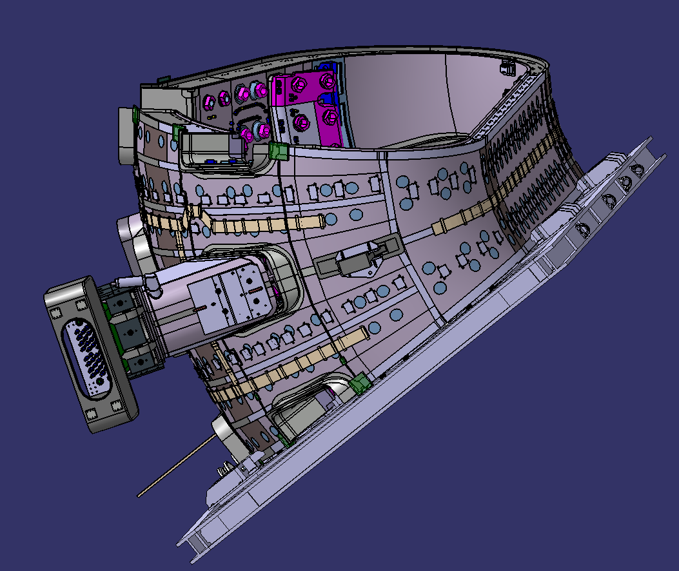
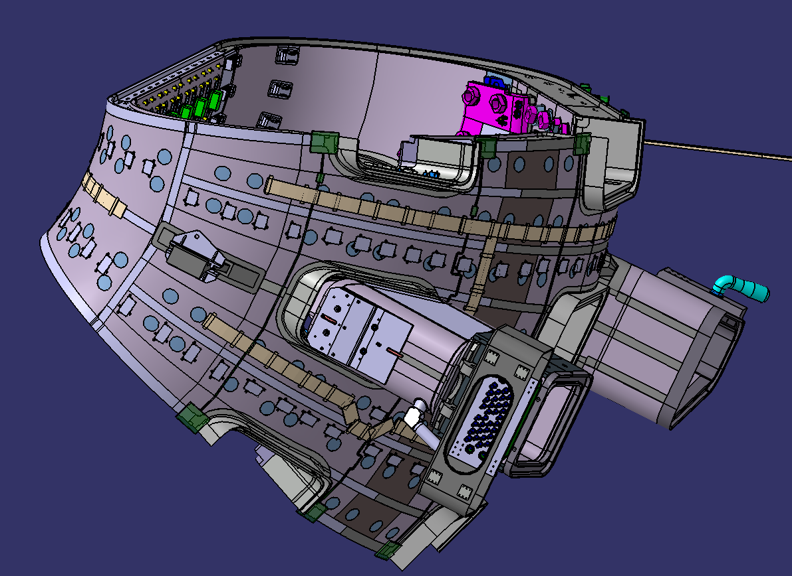
Vacuum Vessel handling
Tool for placing the Vacuum Vessel in work position, considered are the following positions
  Loading position
  Side towards segment 9 horizontal
  Side towards segment 8 horizontal

Slide 3
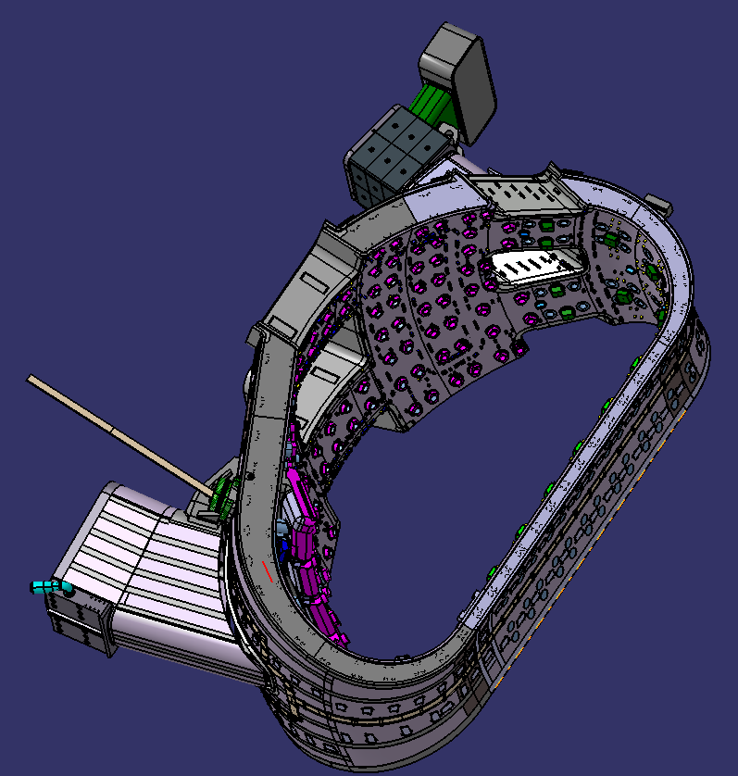
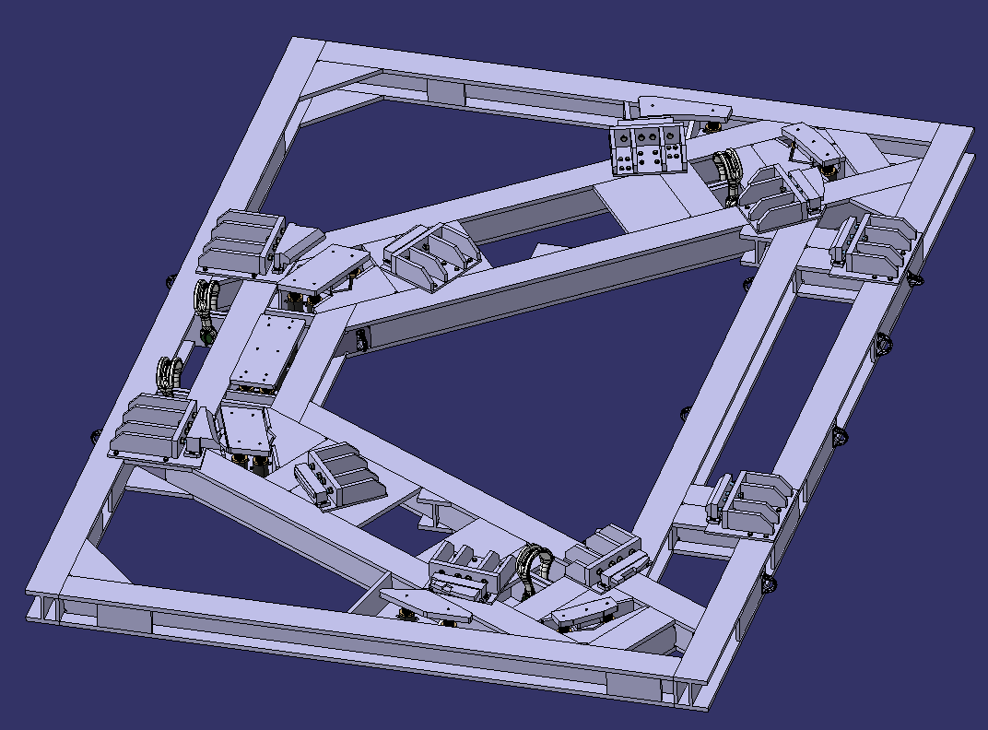
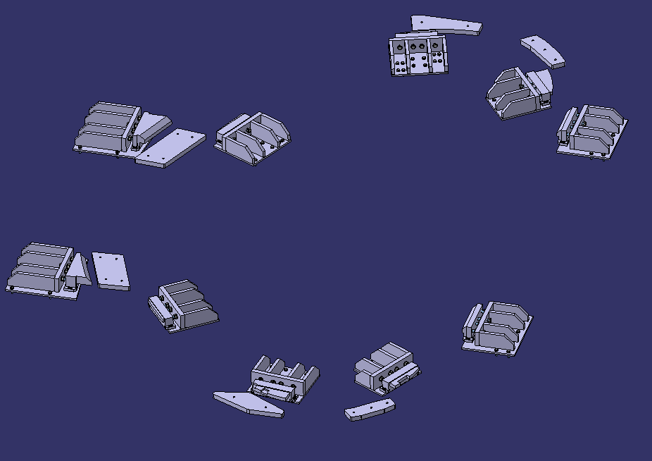
Vacuum Vessel main parameters
Vacuum Vessel and connected Lifting Frame combined weight 450 Ton
The Vacuum Vessel is a protection important component.
First confinement barrier against radiation leakage.
≈13.5m x 8.5m x 6.5m
VV Lifting Frame
VV Support interfaces

Slide 4
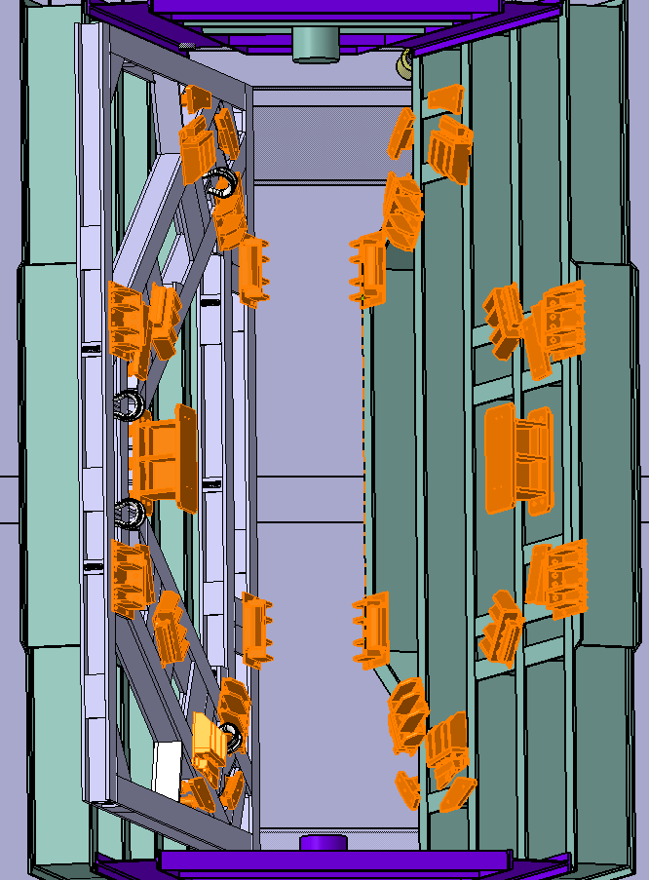
Vacuum vessel interface
The interface of the Vacuum Vessel are to be copied on the handling tool, for one side

Slide 5
Main design considerations
Minimal deformations of Vacuum Vessel
Rather overdesign than detailed analysis
Tooling should be “structure” rather than a lifting accessory
Design for easy manufacture and short lead time
Use of support interfaces of the lifting frame (A detailed analysis of the capabilities of these supports is available)
The Lifting Frame with the Vacuum Vessel is to be clamped, blocked on the handling tool, no structural modifications of the Lifting Frame or the load transfer paths.
Proposed; design with load factor ≈2 and related quality control during manufacture, to justify no load test.
Alternatives possible, depending on cost schedule and related justifications

Slide 6
Main manufacture requirements
Manufacture based EN 1090 quality class 2, for welding quality class 3
Interface with Vacuum Vessel shall be Stainless Steel

Slide 7
Platforms main functions
Access to the Vacuum Vessel in working position
Support for welding robots
Support for milling machines
Platforms shall be easily put in place, consider for example
  Moving by overhead cranes
  Moving by SPMT
Utilities distribution on the platform, minimum connections to building utility connections (quick preparation for moving)

Slide 8
Main design criteria platforms
Weights on the platform, (external, see next slide), 4 sets of
  welding robot, maximum 1.5 Ton
  Milling machine, maximum 2 ton
  6 Control / power cabinets, each approximately 250 kg (total per set 1.5 Ton)
  1 pallet consumables 500 kg
Ensure stability for the machining / welding
Simple solution for managing utilities on the platforms
Gap between platform and Vacuum Vessel ≤ 20 cm
Internal platform supported from the handling frame, load capacity 400 kg/m³, intended for personal access and minor tools

Slide 9
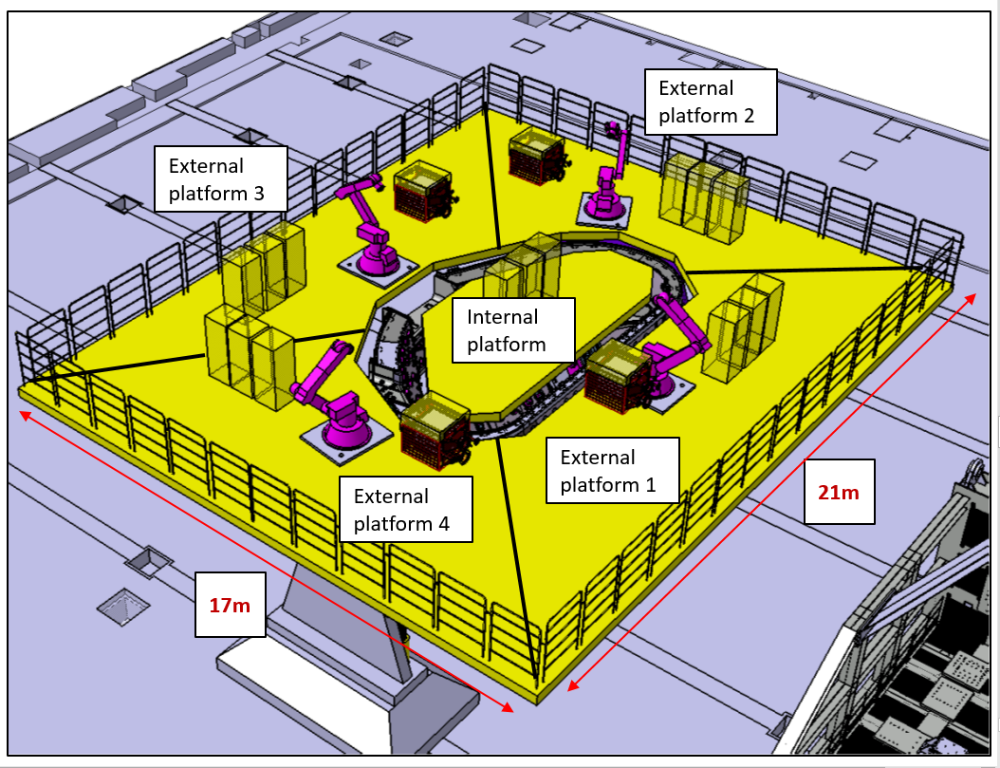
Main parameters platform
Milling machines not shown
The platforms are at approximately 10m above the floor

Slide 10
Manufacture platforms
Manufacture following EN 1090 quality class 2

Slide 11
Market survey questions I
Experience in development concept design to final design
Experience and possibilities to do the interface loading verification with Ansys
What would be subcontracted if anything
References for equivalent projects, include information what are considered the similarities and difference with to proposed project

Slide 12
Market survey questions II
Time estimate to prepare a design ready for manufacture with related engineering file.
Time estimate for manufacture, transport and assembly
Budget estimate, design, material cost, manufacture, transport and assembly
Project risks
Any recommendations for improvements, enabling cost, manufacture time reduction or improvements of functionality

Slide 13
Remark
The intention is to avoid unnecessary heavy documentation requirements.
To ensure the correct treatment of handling a protection important component, the attention will be on:
  Interface loads
  Risk of damage to the Vacuum Vessel due to failure of the handling tooling or the platforms

Slide 14
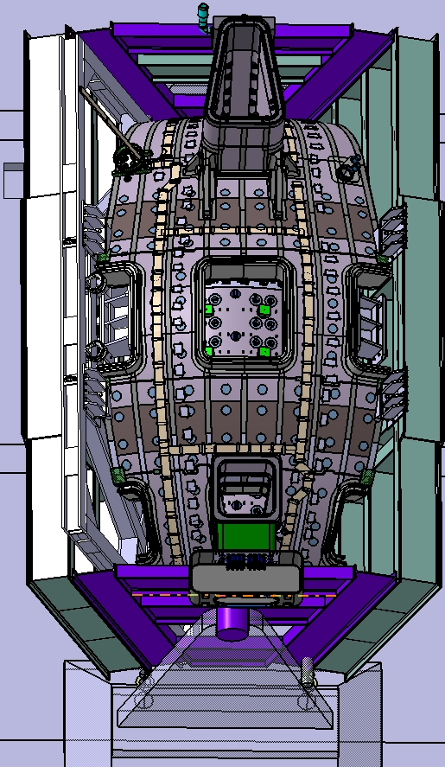
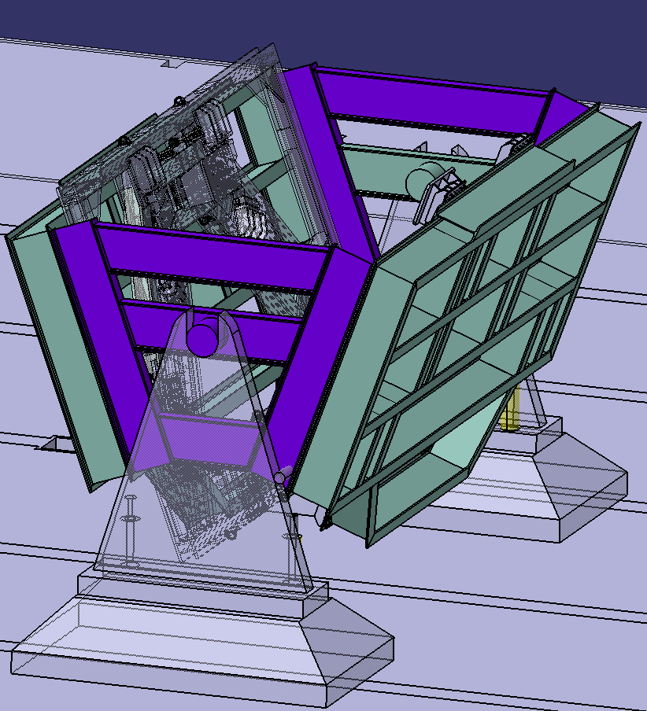
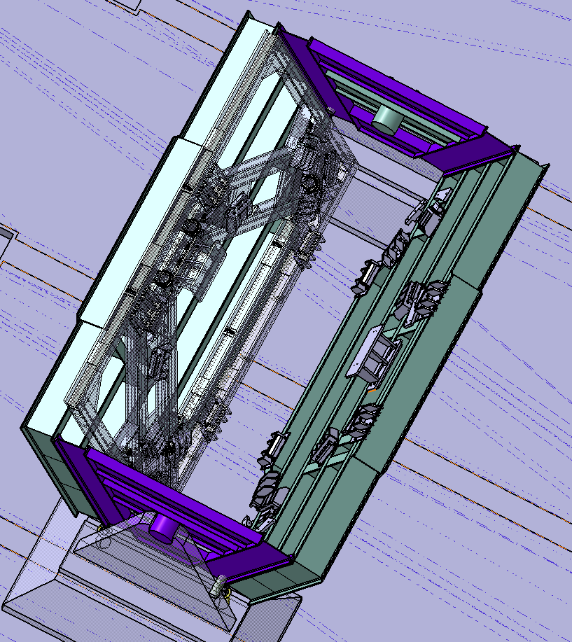
Conceptual design proposal
The support of the trunnion have been indicated only very schematically as they are not considered to be
a design challenge
Proposal is based on
HE-B 1000 beams
The center of gravity of the VV is below the trunnion, meaning that the stable position is as shown in
the picture to the left

Slide 15
Concept Platforms
Large beams close to the Vacuum Vessel, connected by thick plates, for the support of the milling machine and welding robot.
  Minimizing needs for reinforcement to get stiff structure
Towards the outer dimension beams to be optimized in terms of design effort, manufacture time and cost

Slide 16
Annex
Operation steps

Slide 17
Start handling operation
Vacuum Vessel on Lifting frame in Up-Ending tool

Slide 18
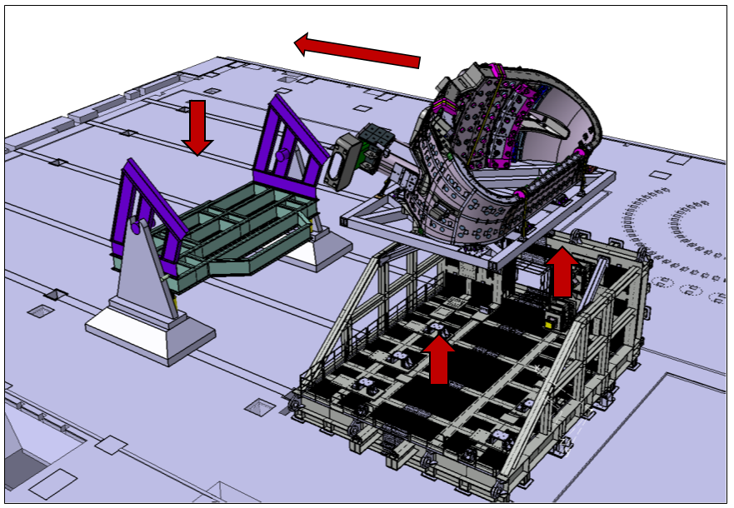
VV lifted horizontally on its handling frame and placed on Tilting frame
Standard horizontal lift

Slide 19
VV installed and secured on Tilting frame

Slide 20
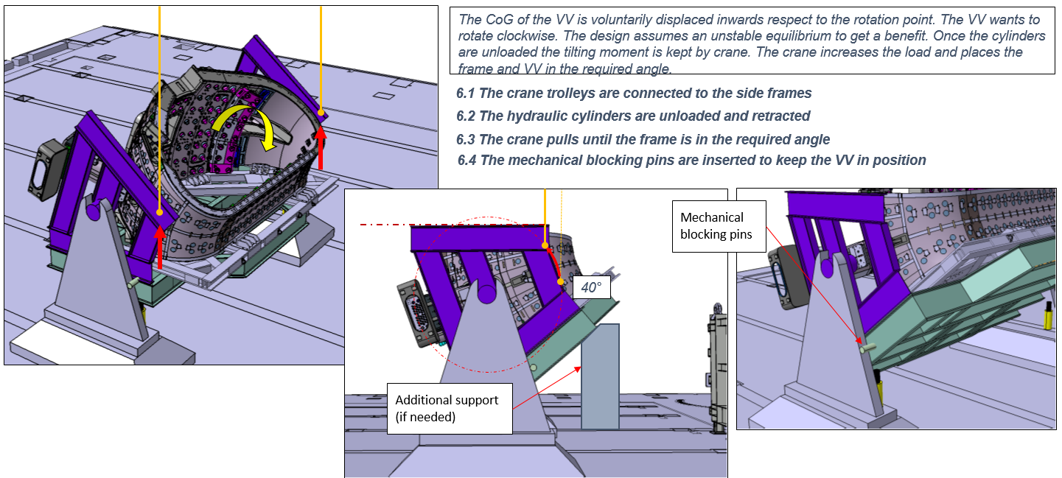
Rotation of 40 degrees to working position

Slide 21
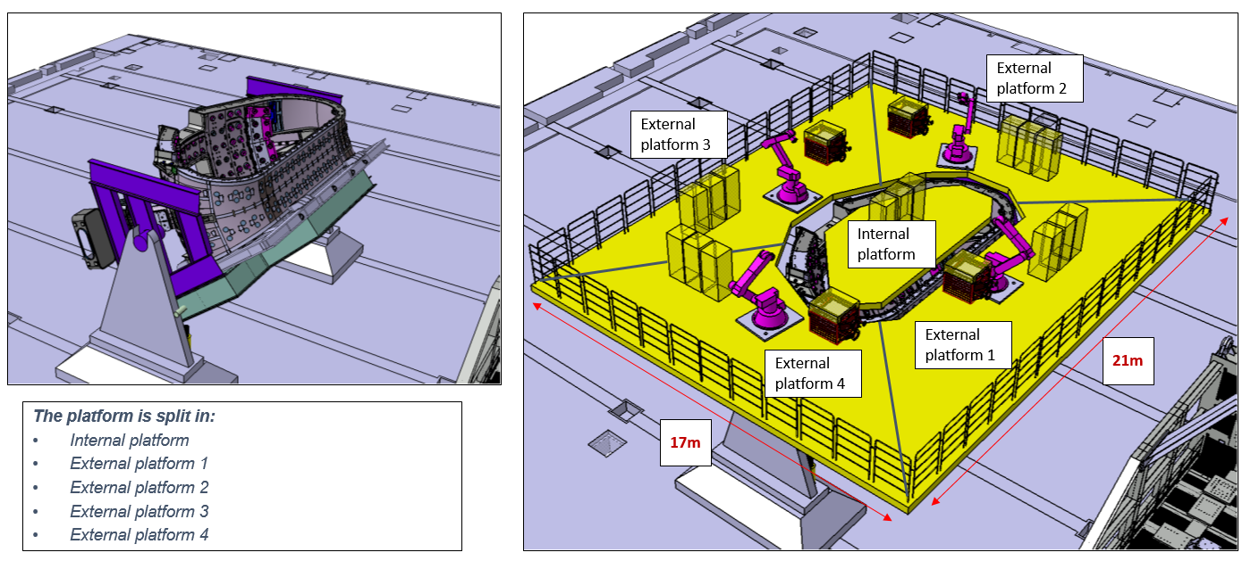
Installation of access platforms and tooling

Slide 22
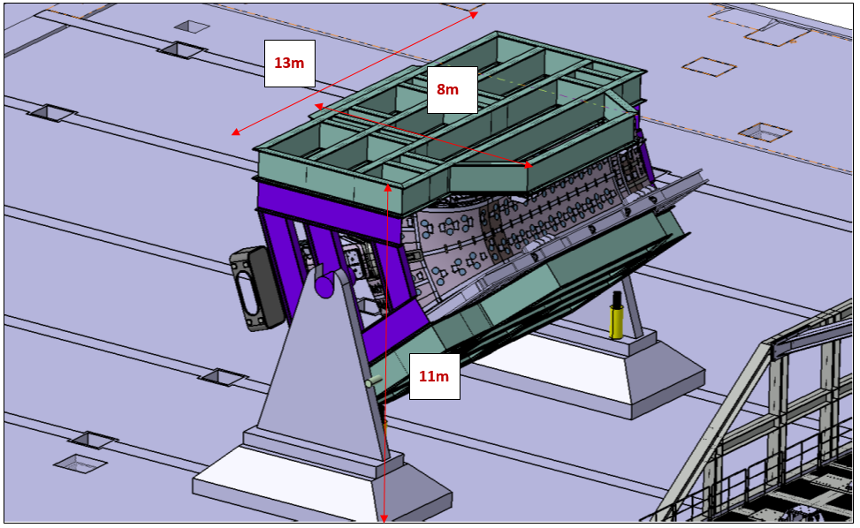
Following Vacuum Vessel operation completion, removal of equipment and installation of top face frame

Slide 23
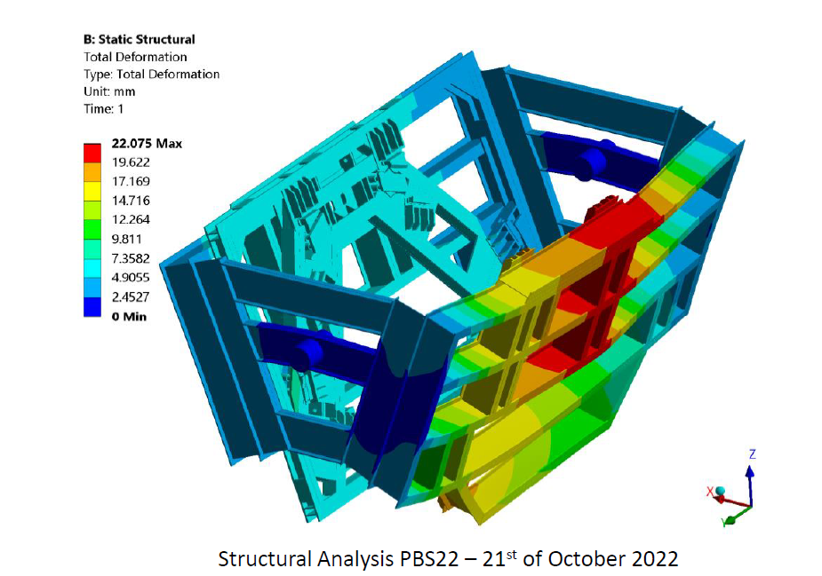
First analysis, maximum loading during rotation

Slide 24
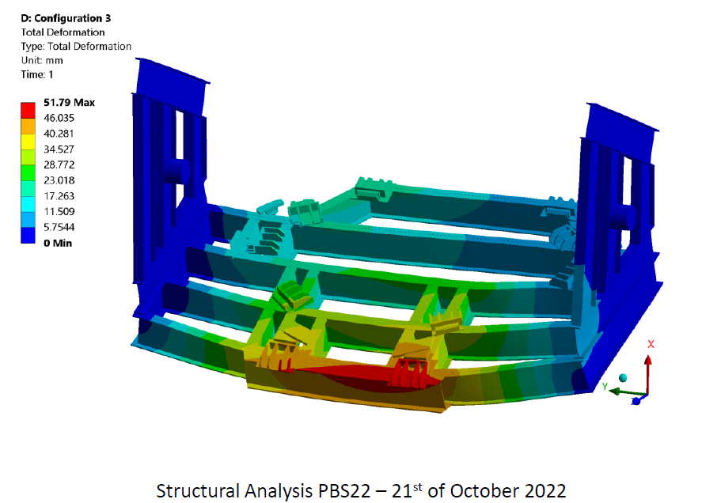
First analysis, working position side no lifting frame
Conclusion first analysis:
In general the structure is OK.
However;
The structure is not stiff enough in the highest loaded region

